Slide 1

DriverPass System Analysis
Matthew Trembley
Notes:
[No speaker notes required for this slide.]

Slide 2

System Requirements
Functional Requirements
Shall validate users’ credentials upon login
Allow for users to book lessons
Nonfunctional Requirements
Will be web-based cloud system
Will be updated whenever DriverPass would like to add new features or whenever the DMV changes rules/regulations.
Notes:
Here are some of the most important requirements for the system for DriverPass. We will start with the functional requirements. First, the system shall validate users’ credentials upon login. This is an incredibly important performance requirement that also ties into security. Next is to allow for users to book lessons. This will allow the system to be a bit more flexible in terms of who can interact with it. For nonfunctional requirements, per request it will be a web-based cloud system. This is to help take care of the backend support for DriverPass’s small team. Next,the system shall be updated whenever the DMV makes changes to rules and/or regulations or if DriverPass would like to add new features. This keeps the system current and up-to-date, so the information isn’t outdated and unreliable for new customers.

Slide 3
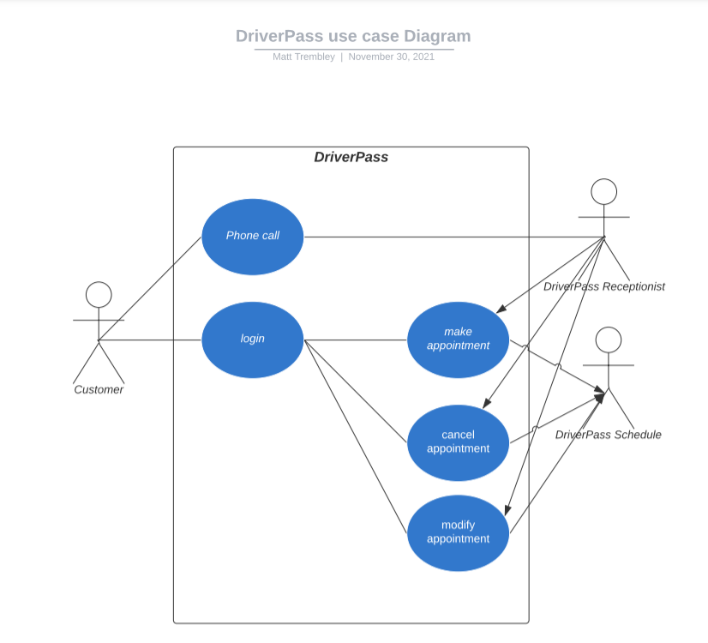
Use Case Diagram
[Insert your use case diagram here.]
Notes:
Here we have a simple use case diagram of the DriverPass system and how appointments can be handled. As you see there are 3 figures outside the box, Customer, DriverPass Receptionist, and DriverPass Schedule. These three figures, or actors, is what interacts with the different processes inside of the box. The use cases of make appointment, cancel appointment, and modify appointment, all interact with the different users. The customer can make a phone call and the receptionist can interact with the system, which then amends the schedule. Or the customer can log in and directly interact with the system themselves.

Slide 4
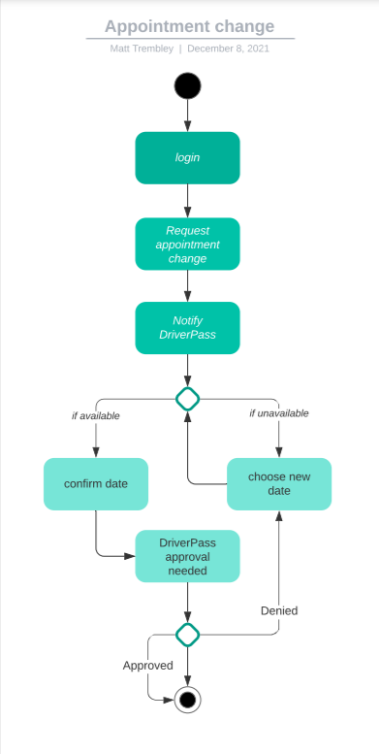
Activity Diagram
Notes:
Now this diagram is the process for when a customer changes an appointment. First off, they need to login. Then, they will need to request an appointment change which will then notify DriverPass and choose a new date. If it is available, it will need to be approved by DriverPass. If it is approved, the customer will receive confirmation. If the date is not available, they will need to choose a new date until it is. This keeps DriverPass in the loop of any changes and keeps a record for if a customer seems to change appointments constantly.

Slide 5
Security
Username/password logins
Cloud is responsible party for connection and data exchanges
System will disable account after X amount of login attempts
“Forgot Password?” function to user email
Notes:
[How did you consider security in your design? In your explanation, keep your audience in mind by avoiding the use of technical terms.]
Security is very big in this system. First off, all users will use a username/password combination, which is case sensitive and verified by email, to sign up. Next, the 3rd party responsible for the cloud, which is yet to be determined, is responsible for the connection and any data exchanges. This moves the liability to the 3rd party and relieves DriverPass of the backend support needed. Next, the system will disable an account after X amount of login attempts, which is yet to be decided. This will prevent any “brute force” hacking into customer or employee accounts. Last, the forgot password function will be explicitly linked to the user’s email, which is an assumption that the user is the only one with access to the corresponding email account..

Slide 6
System Limitations
There is about 4 months to make this system
There was no budget given
There are not many employees to help create the system
Notes:
Now as far as design limitations there isn’t much. But overall, there is some project limitations that will need to be addressed. First, there is about 4 months to develop this system, which would put the team in a crunch time position. Next, there was no budget given for this, which is a huge deal in case DriverPass needs any hardware, choosing a cloud service to use, and the amount of maintenance that will go into the system after implementation. Last but not least, which somewhat coincides with the budget, there is not many employees to help create the system on our end. It is a somewhat ambitious system, but not one that is out of reach, so it will be necessary to allocate the manpower to help develop it.

